Slide 1
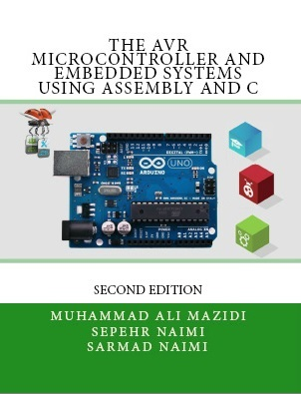

I2C and RTC
Chapter 18
Sepehr Naimi
www.NicerLand.com

Slide 2
I2C History
IIC: Inter-Integrated Circuit
Philips
1982
Aim: connecting many devices (around 128 devices) to the MCU using two wires

Slide 3
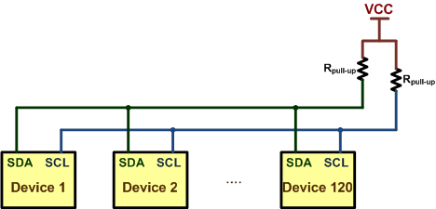
Connecting devices using I2C
SDA: Serial Data
SCL: Serial Clock
Open-collector devices (Wire AND)

Slide 4
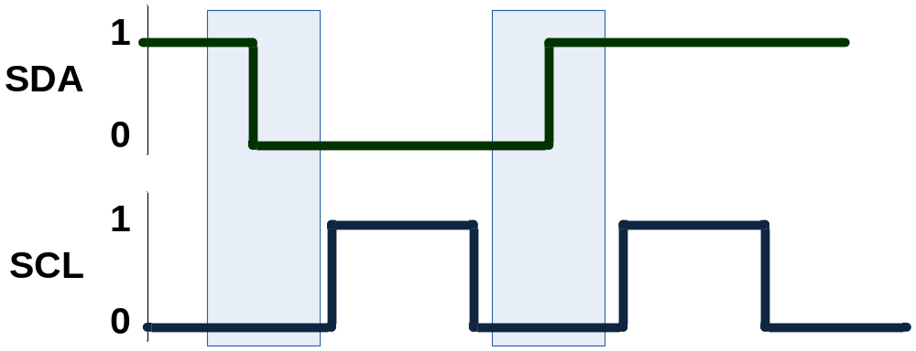
Sending bits of data
The SDA values changes when SCL is low.
The receiver reads SDA on the falling edge of SCL.

Slide 5
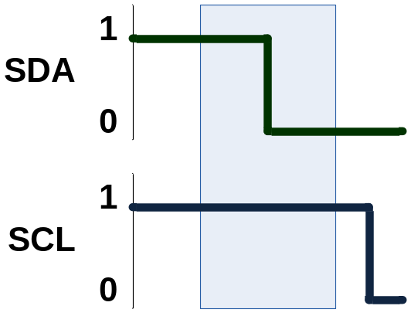
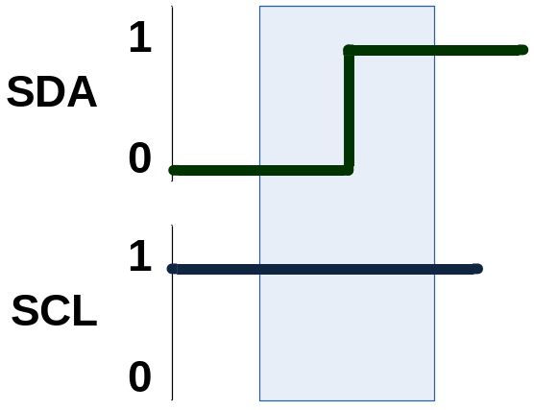
Start and Stop conditions
Start
Stop

Slide 6
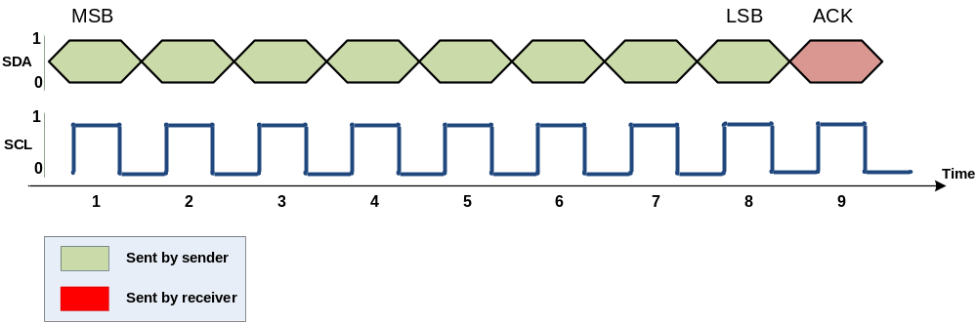
Packet Format
Each packet is 9 bits long.
First 8 bits are put on SDA by the transmitter
The 9th bit is an acknowledge by the receiver
  NACK (leave high) or ACK (pull down)

Slide 7
Master vs. Slave
Master
  Begins the communication
  Chooses the slave
  Makes clock
  Sends or receives data
Slave
  Responds to the master
  Each slave has a unique 7-bit address

Slide 8
Master vs. Slave (Cont.)
There might be more than 1 master on an I2C bus
Each device can be both Master and Slave

Slide 9
Steps of a communication
Start
Address
Send or Receive (Write or read)
Acknowledge
Send/receive a byte of data
Acknowledge
Stop

Slide 10
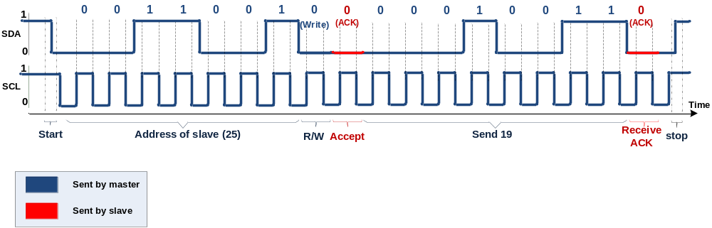
Sending a byte
Sending 19 to device 25.

Slide 11
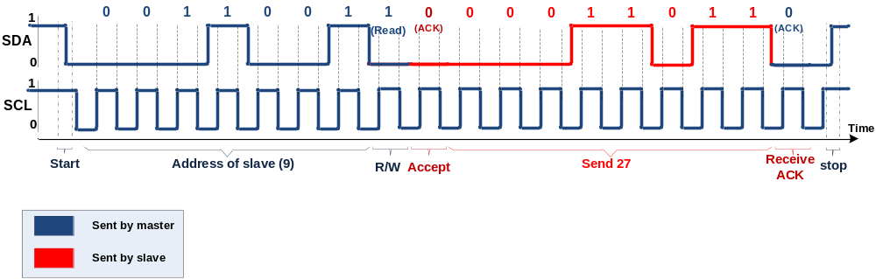
Receiving a byte from Device 9

Slide 12
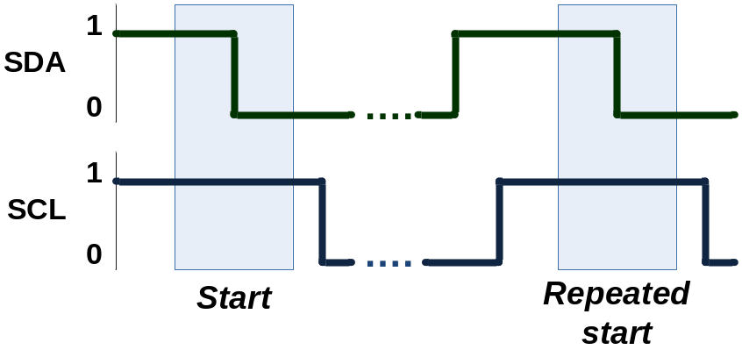
Repeated start
A new Start condition before the Stop condition

Slide 13
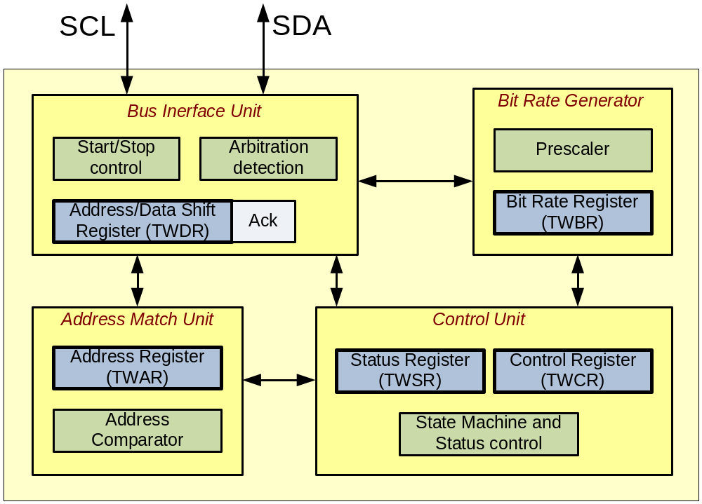
I2C (TWI) Unit in AVR
Notes:
Bus Interface Unit
detects and generates START, REPEATED START and STOP conditions.
detects arbitration
controls sending or receiving ACK
transfers packets of data or address.
Bit Rate Generation Unit
controls the frequency of the system clock (SCL) when operating in a master mode
Address Match Unit
Compares the received address byte with the 7-bit address in TWI address register and informs the control unit upon an address match.
Control Unit
controls the TWI module and generates responses according to settings in the TWI control register
sets the contents of the status register
according to current state.

Slide 14
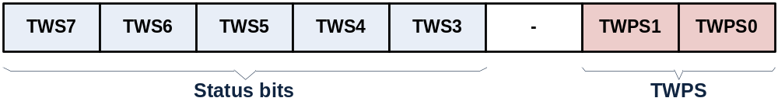
TWSR (TWI Status Register)

Slide 15
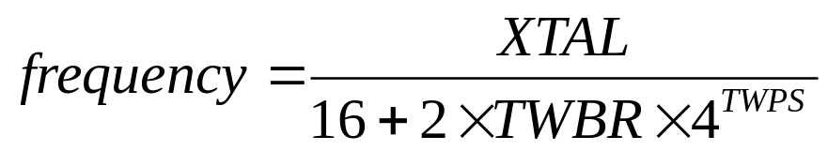
TWBR (TWI Bit Rate) Register
TWBR:
TWSR:

Slide 16
TWCR
TWINT: TWI Interrupt flag
TWEA: TWI Enable Acknowledge bit
  1:ACK, 0:NACK
TWSTA: TWI Start condition bit
TWSTO: TWI Stop condition bit
TWWC: TWI Write Collision flag
TWEN: TWI Enable bit
TWIE: TWI Interrupt Enable
TWCR:

Slide 17
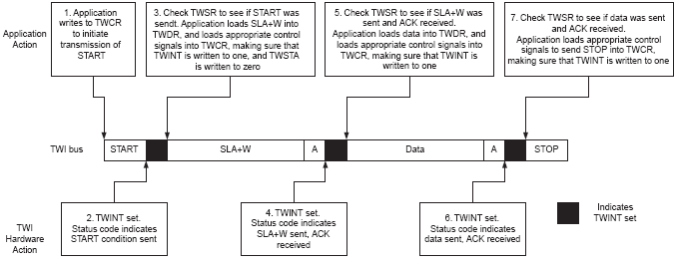
TWI Control Register

Slide 18
TWAR (TWI Address Register)
TWA6-0 (TWI slave Address)
TWGCE (TWI General Call Recognition Enable bit)
  1: Answer to general call
TWAR:

Slide 19
TWDR (TWI Data Register)

Slide 20
TWI, Master Mode programming
Initializing
  Set the TWI module clock frequency by setting the values of the TWBR register and the TWPS bits in the TWSR register.
  Set the TWEN bit in TWCR to one to enable the TWI module
Transmit START condition
  Set TWEN, TWSTA, and TWINT bits of TWCR to one.

Slide 21
TWI, Master Mode programming
Send Data
  Copy the data byte to the TWDR
  Set the TWEN and TWINT bits of the TWCR to one to start sending the byte.
  Poll TWINT flag in TWCR register to see whether the byte transmitted completely
Receive Data
  Set TWEN and TWINT bits of TWCR to one to start receiving a byte.
  Poll TWINT flag in TWCR to see whether a byte has been received completely
  read the received byte from the TWDR

Slide 22

TWI, Master Mode programming
Transmit STOP condition
  Set TWEN, TWSTO, and TWINT bits of TWCR to one
    Note: we cannot poll the TWINT flag after transmitting the STOP condition

Slide 23
Writing and reading a byte in master mode
#include <avr/io.h>
void i2c_write(unsigned char data)
{
TWDR = data ;
TWCR = (1<< TWINT)|(1<<TWEN);
while ((TWCR & (1 <<TWINT)) == 0);
}
//***************************************************
unsigned char i2c_read(unsigned char isLast)
{
if (isLast == 0) //send ACK
TWCR = (1<< TWINT)|(1<<TWEN)|(1<<TWEA); //send ACK
else
TWCR = (1<< TWINT)|(1<<TWEN); //send NACK
while ((TWCR & (1 <<TWINT)) == 0);
return TWDR;
}
void i2c_start(void)
{
TWCR = (1 << TWINT) | (1 << TWSTA) | (1 << TWEN);
while ((TWCR & (1 << TWINT)) == 0);
}
void i2c_stop()
{
TWCR = (1<<TWINT)|(1<<TWEN)|(1<<TWSTO);
}
void i2c_init(void)
{
TWSR=0x00; //set prescaler bits to zero
TWBR=152; //SCL frequency is 50K for XTAL = 16M
TWCR=0x04; //enable the TWI module
}
int main (void)
{
i2c_init();
//writing a byte
i2c_start(); //transmit START condition
i2c_write(0b11010000); //transmit SLA + W(0)
i2c_write(0b11110000); //transmit data
i2c_stop(); //transmit STOP condition
//reading a byte
i2c_start(); //transmit START condition
i2c_write(0b11010001); //transmit SLA + R(1)
PORTD =i2c_read(1); //read one byte of data
i2c_stop(); //transmit STOP condition
while(1); //stay here forever
}

Slide 24
TWI, Slave Mode programming
Initializing
  Set the slave address by setting the values for the TWAR register.
    7 bits for address
    8th bit is TWGCE ( 1 = answer general calls)
  Set the TWEN bit in TWCR to one to enable the TWI module
  Set the TWEN, TWINT, and TWEA bits of TWCR to one to enable the TWI and acknowledge generation
Listening
  poll the TWINT flag to see when the slave is addressed by a master device or use its interrupt

Slide 25
TWI, Slave Mode programming
Send Data
  Copy the data byte to the TWDR
  Set the TWEN, TWEA, and TWINT bits of the TWCR register to one to start sending the byte.
  Poll TWINT flag in TWCR register to see whether the byte transmitted completely
Receive Data
  Set TWEN and TWINT bits of TWCR to one to start receiving a byte.
  Poll TWINT flag in TWCR to see whether a byte has been received completely
  read the received byte from the TWDR

Slide 26
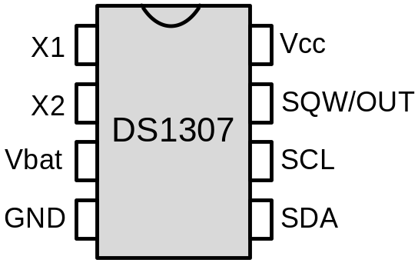
DS1307
RTC (Real-time clock)
Keeps time and date

Slide 27
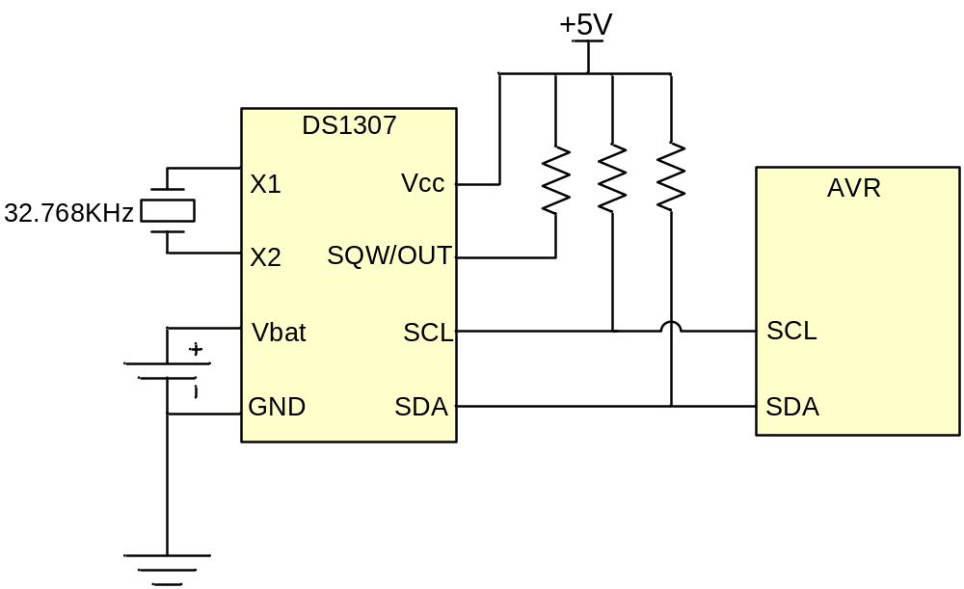
Connecting DS1307 to the AVR

Slide 28
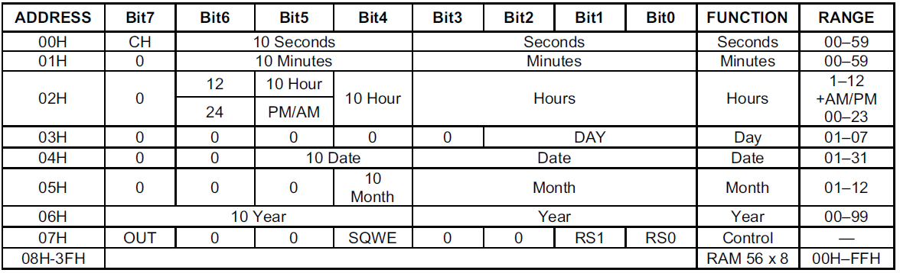
DS1307 address map
  64 bytes of RAM
  BCD format is used
  Bit7 of address location 0 (CH) should be zero to enable the oscillator
  Address location 07 is the control register

Slide 29
Register Pointer in DS1307
In DS1307 there is a register pointer that specifies the byte that will be accessed in the next read or write command.
After each read or write operation, the content of the register pointer is automatically incremented. It is useful in multi-byte read or write.
Register pointer:

Slide 30
Write to DS1307
Transmit START condition
Transmit the address of DS1307 (1001101) followed by 0 to indicate a write operation
Transmit the address of location you want to access (it set the value of Register Pointer)
Transmit one or more bytes of date
Transmit STOP condition

Slide 31
Read from DS1307
Transmit START condition
Transmit the address of DS1307 (1001101) followed by 1 to indicate a read operation
Receive one or more bytes of date
Transmit STOP condition
  Note: the register pointer indicates which address will be read (you should set it using a write operation)

Slide 32
Set Time and Get Time
void rtc_setTime(unsigned char h,unsigned char m,unsigned char s)
{
i2c_start(); //transmit START condition
i2c_write(0xD0); //address DS1307 for write
i2c_write(0); //set register pointer to 0
i2c_write(s); //set seconds
i2c_write(m); //set minutes
i2c_write(h); //set hour
i2c_stop(); //transmit STOP condition
}
void rtc_getTime(unsigned char *h,unsigned char *m,unsigned char *s)
{
i2c_start(); //transmit START condition
i2c_write(0xD0); //address DS1307 for write
i2c_write(0); //set register pointer to 0
i2c_stop(); //transmit STOP condition
i2c_start(); //transmit START condition
i2c_write(0xD1); //address DS1307 for read
*s = i2c_read(1); //read second, return ACK
*m = i2c_read(1); //read minute, return ACK
*h = i2c_read(0); //read hour, return NACK
i2c_stop(); //transmit STOP condition
}

Slide 33
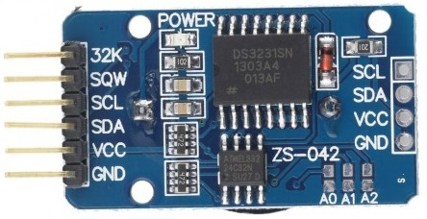
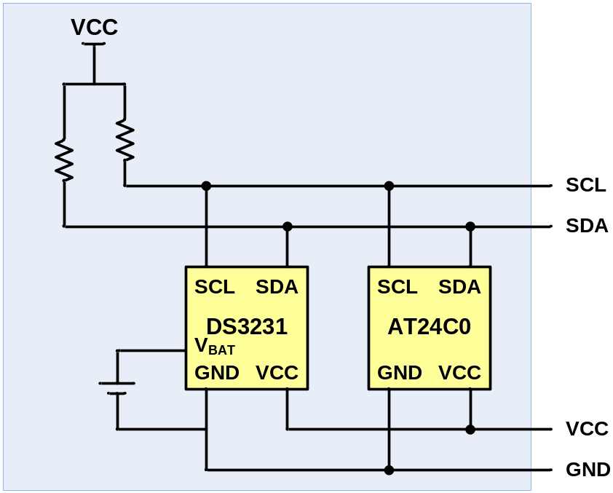
DS3231 module
Similar to DS1307

Slide 34
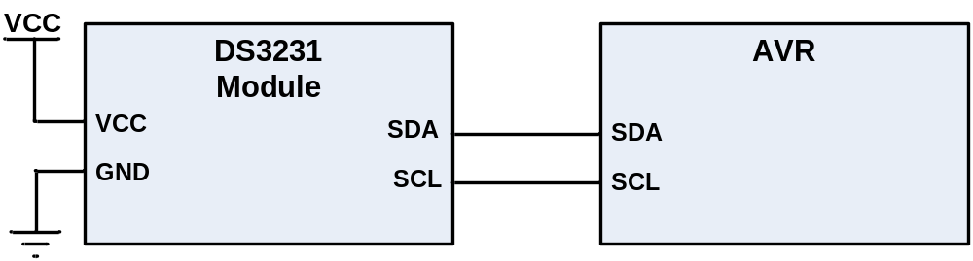
Connecting DS3231 to AVR

